Slide 1
How to Succeed in Your Degree
Dr Andy MacLachlan
Associate Professor in Spatial Data Science and Visualisation

Slide 2
Aims of this session
This session was inspired by the difficulties encountered by some of our students in the last couple of years. By giving you this information now, hopefully you will be able to avoid some of the pitfalls they encountered!
I hope to arm you with a range of
Strategies
Hints
Tips
titbits of advice
… which will allow to you embark upon your degree knowing what you can do to achieve the best result you can
PROBLEMS AND KEYS

Slide 3
Ready to go?

Slide 4
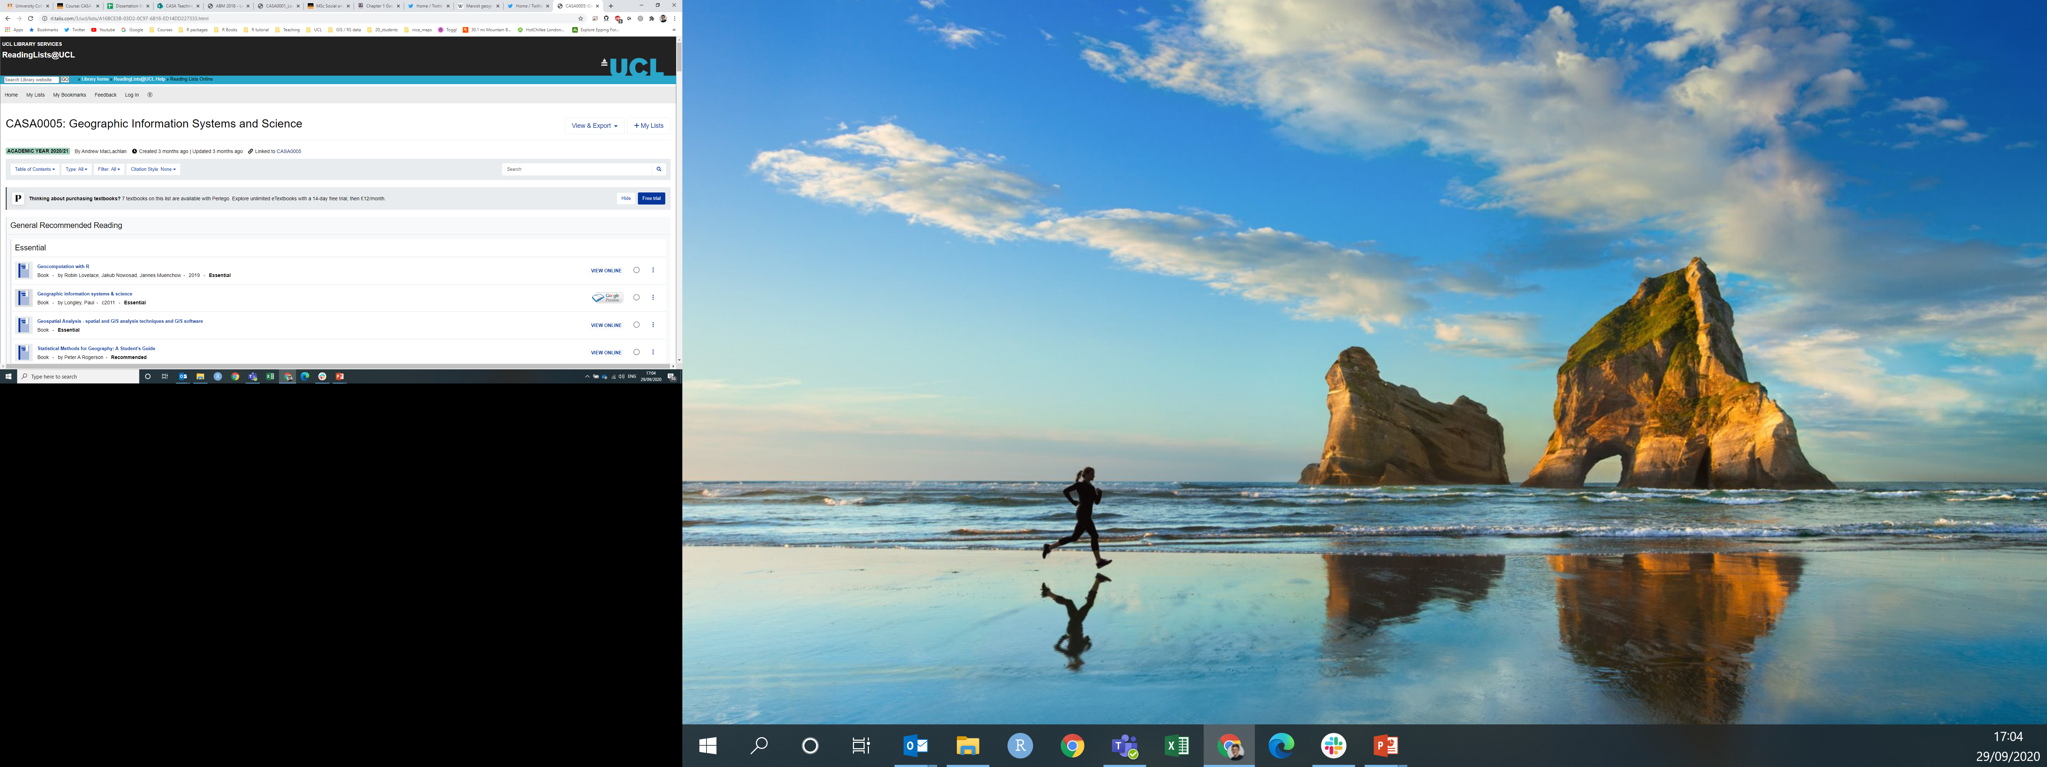
Key to success #1: Reading
Reading widely
being critical (just because someone wrote it on a page, it doesn’t mean it’s correct!) and
knowing where to find the best material is vital to success in your degree
Every module will have recommended reading list – visit http://readinglists.ucl.ac.uk/
Reading lists are a good place to start and will often link to entries directly in the UCL Library

Slide 5
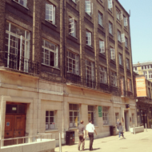
Key to success #1: Reading
The UCL Library Services Website is a very good place to start if you want to find books located in UCL http://www.ucl.ac.uk/library/
UCL has lots of libraries – discover the important ones for you are this week
You will probably find most useful items in the UCL Science Library, the Bartlett Library or we have a small CASA library where you can borrow books

Slide 6
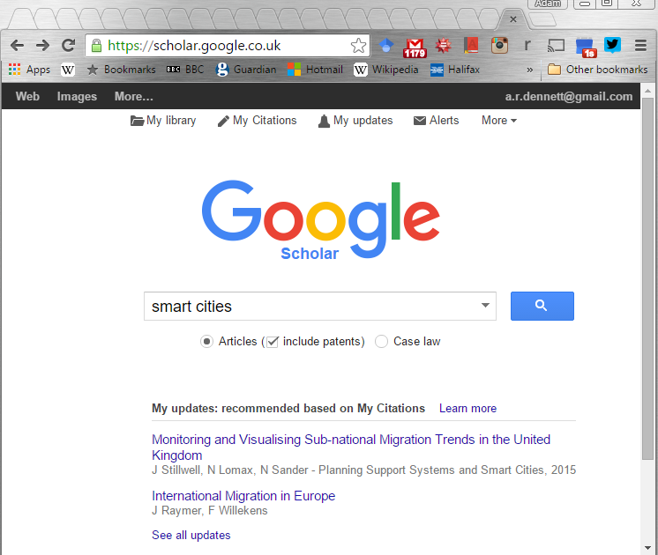
Key to success #1: Reading
Find academic articles using google scholar – it’s great!
https://scholar.google.com/
Much better than a standard google search for finding books, journal articles, working papers etc.

Slide 7
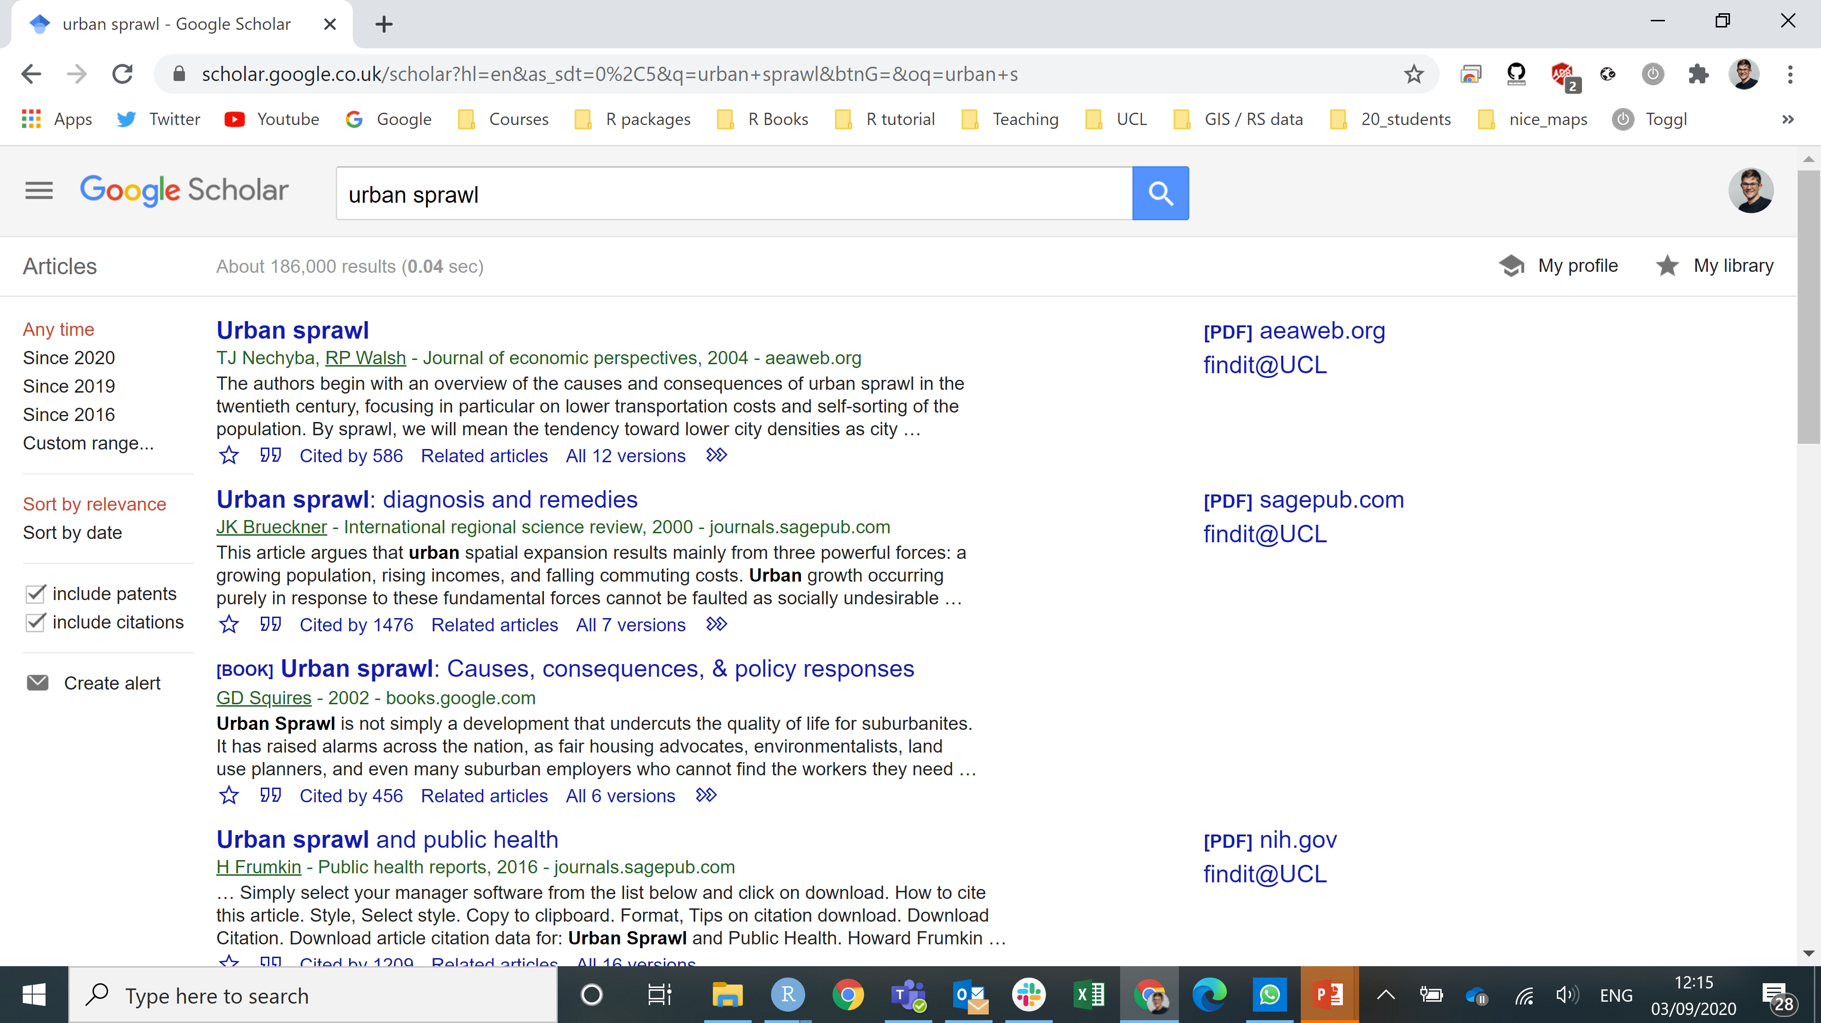
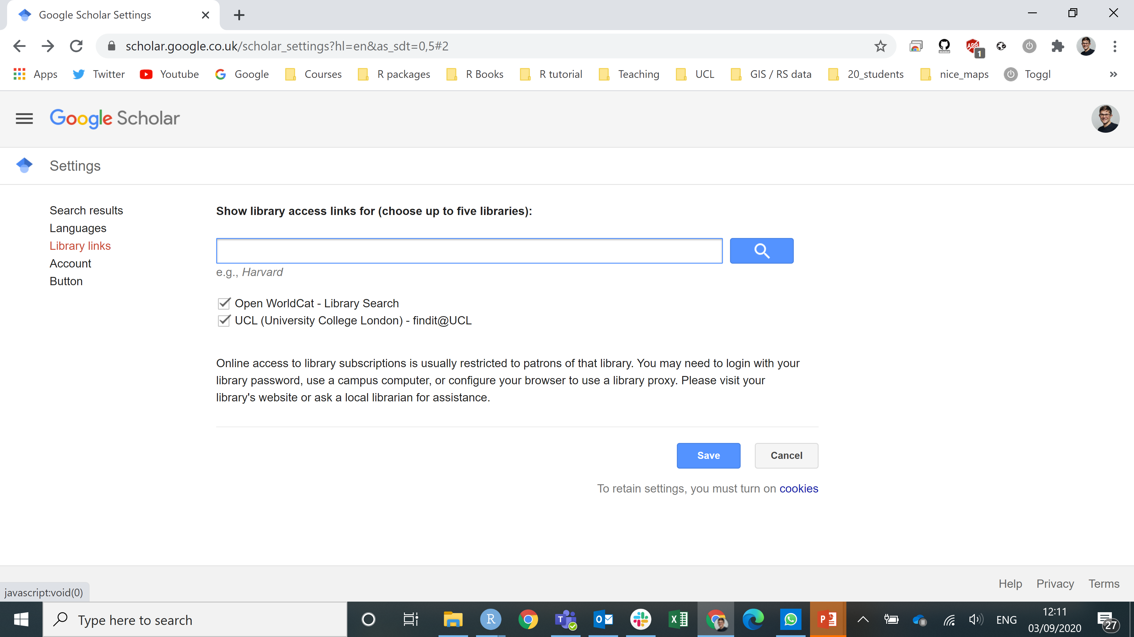
Key to success #1: Reading
You can also link Google scholar to the UCL library, so if you find an article you might like to read Google will give you the UCL link to access it!

Slide 8
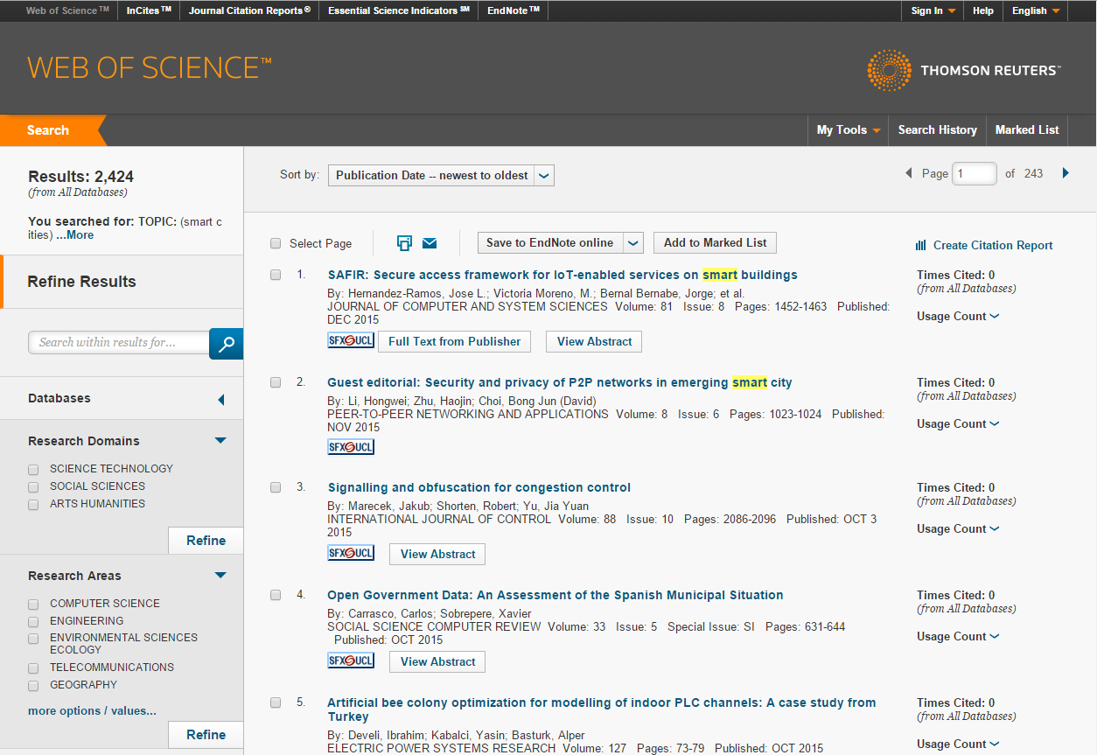
Key to success #1: Reading
Web of Science is also an excellent search tool for finding academic articles
https://www.webofscience.com/wos/woscc/basic-search
Will link to items in the UCL catalogue as you will log in via your institutional credentials

Slide 9
Key to success #1: Reading
Read widely????
1. set the scene reading
Agendas / broad journals
2. technical reading
Specialist journals
1. set the scene reading
UN Sustainable Development Goals
C40 cities
Give cities a seat at the top table, Acuto 2016
Scientists must have a say in the future of cities, McPherson 2016
Global science for city policy, Acuto 2018
London Plan
New Urban Agenda
2. technical reading
The detail of the method you are using = where, how +why

Slide 10
Key to success #2: Writing
Being able to write well is absolutely key to success
If you are unable to present your argument well in English, your grades will suffer accordingly
Poor quality of written English a contributing factor in failed CASA dissertations in the past
There are a number of factors which could lead to poor written work, but fortunately there are solutions to all of them…

Slide 11
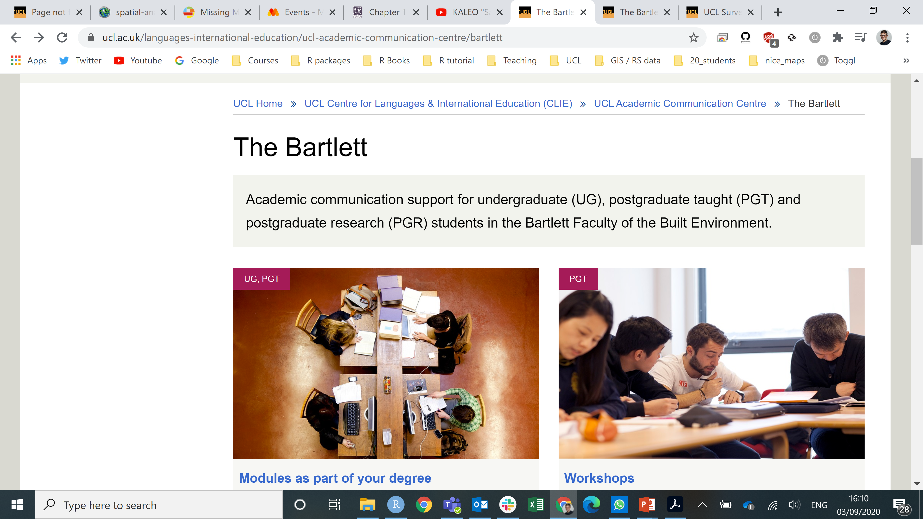
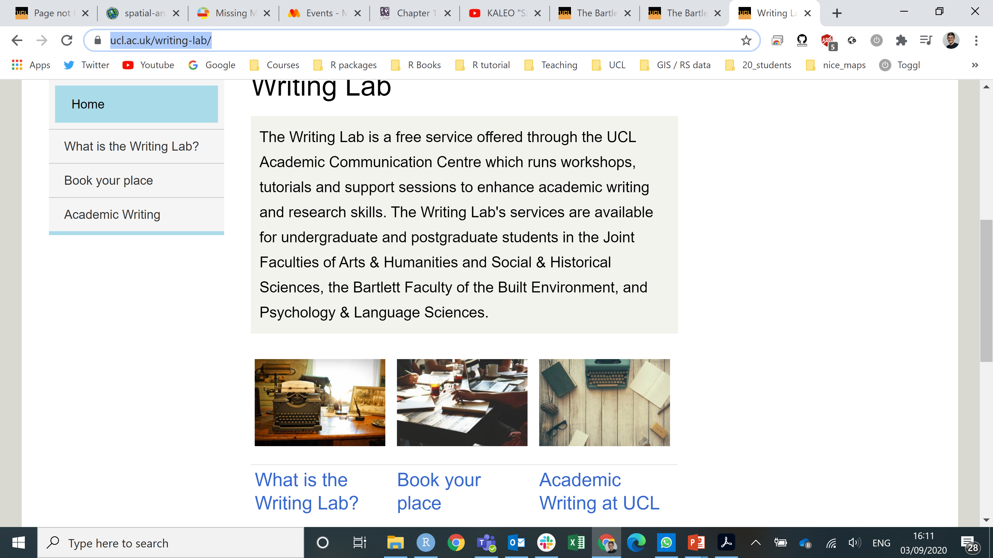
Writing Problem 1 – Non-native English Speaker
If English isn’t your first language the UCL Centre For Languages & International Education has taught courses which run during the term:
https://www.ucl.ac.uk/languages-international-education/ucl-academic-communication-centre
UCL Mobile Apps:
http://www.ucl.ac.uk/english-usage/apps/
The Writing Lab*: https://www.ucl.ac.uk/writing-lab/

Slide 12
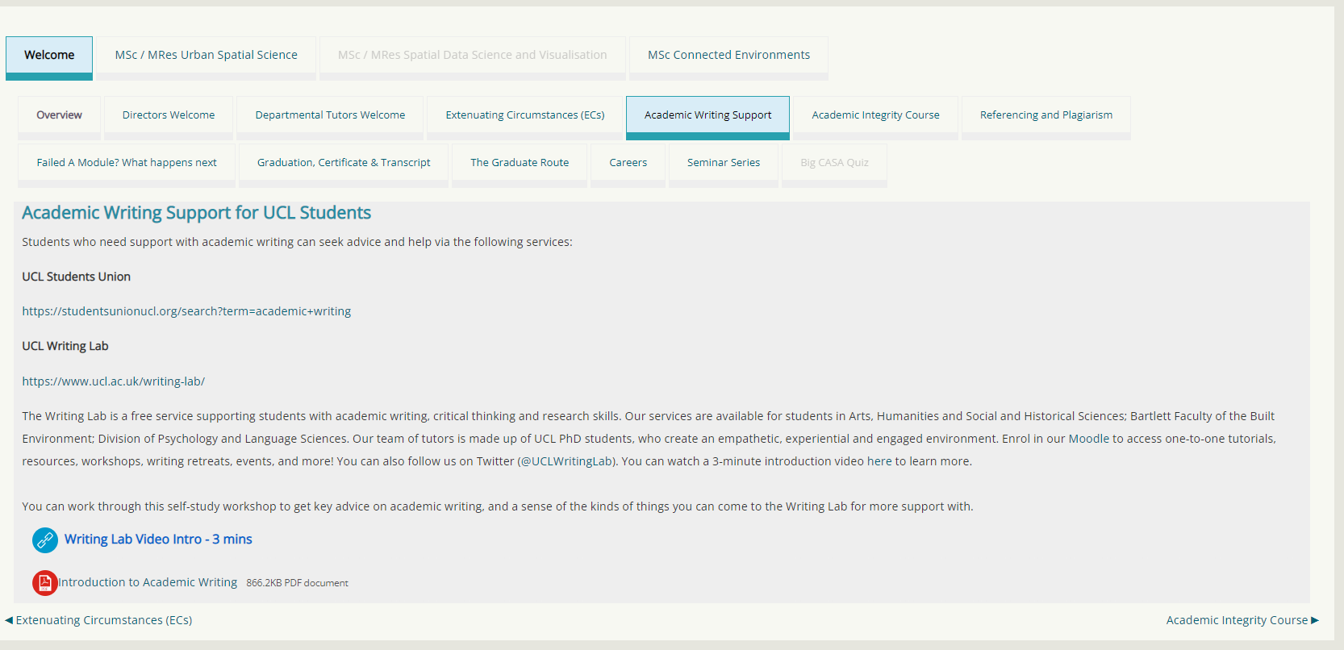
Writing Problem 1 – The Writing Lab

Slide 13
Writing Problem 2 – Unfamiliar with writing in an academic style
Develop through the programme and modules.
Other resources:
UCL Transition Study Skills:
https://www.ucl.ac.uk/writing-lab/online-resources/help-at-ucl
The UCL Institute of Education has excellent online guides:
http://www.ucl.ac.uk/ioe-writing-centre
Moocs are available elsewhere:
https://www.edx.org/course/how-write-essay-uc-berkeleyx-colwri2-1x?utm_source=Course+Announcements+Mailing+List&utm_medium=email&utm_content=title&utm_campaign=Student_Newsletter_September_1#!

Slide 14
Task 1 – (10 Minutes)
Read through these two introductions (both submitted in previous years as part of the GIS Coursework Assessment)
Which is the better introduction?
Why? (List as many reasons as you can think of…)

Slide 15
Which is better?
Why?

Slide 16
Marshalling your arguments
Read hand out

Slide 17
Writing Problem 3 – Unsure how to correctly reference you work and build a bibliography
Variety of academic referencing styles – we prefer Harvard referencing: https://www.ucl.ac.uk/ich/services/library/resources/harvard
Bao (2003) compares this population group with…
An earlier study (Bao, 2003) concluded that…
Smith et al. (2006) conducted a situation analysis…
Al-Hasani (2003, p27) stated that “this method is more suitable for analysis of complex emergency situations”

Slide 18
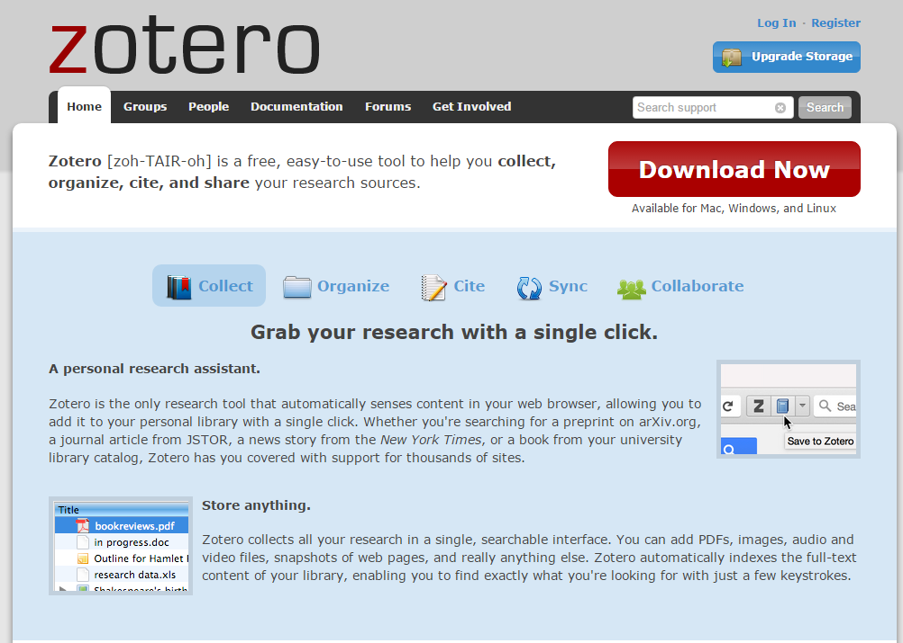
Writing Problem 3 – Unsure how to correctly reference you work and build a bibliography
Reference management software is BRILLIANT so use it!!
Zotero is FREE and works across multiple platforms
https://www.zotero.org/

Slide 19
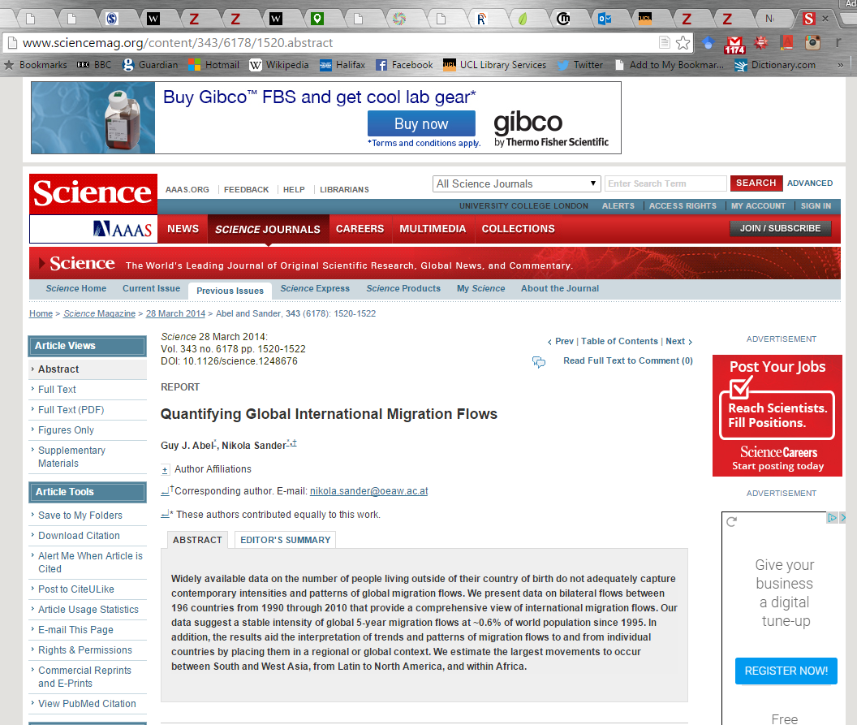
Zotero
Add citations to your library with ONE CLICK!! In your Firefox or Chrome browser
Will automatically detect whether a journal article, book, webpage etc.

Slide 20
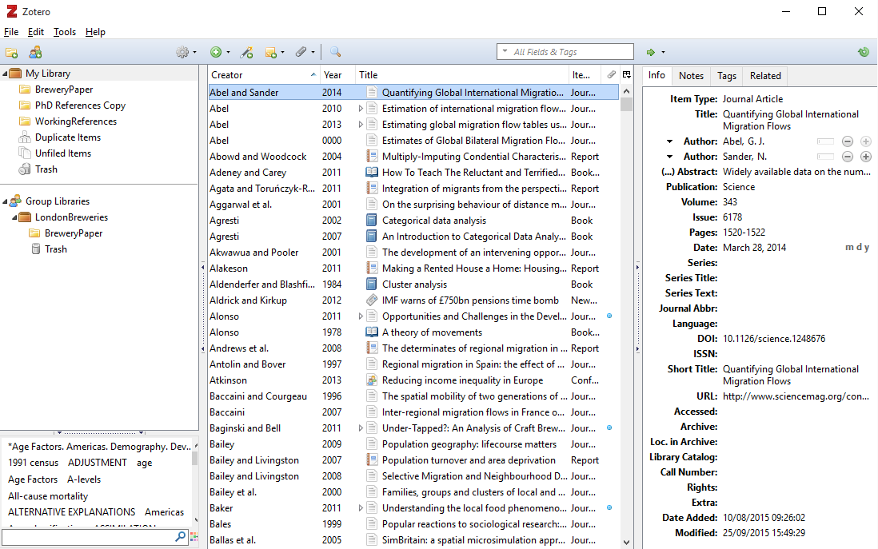

Slide 21
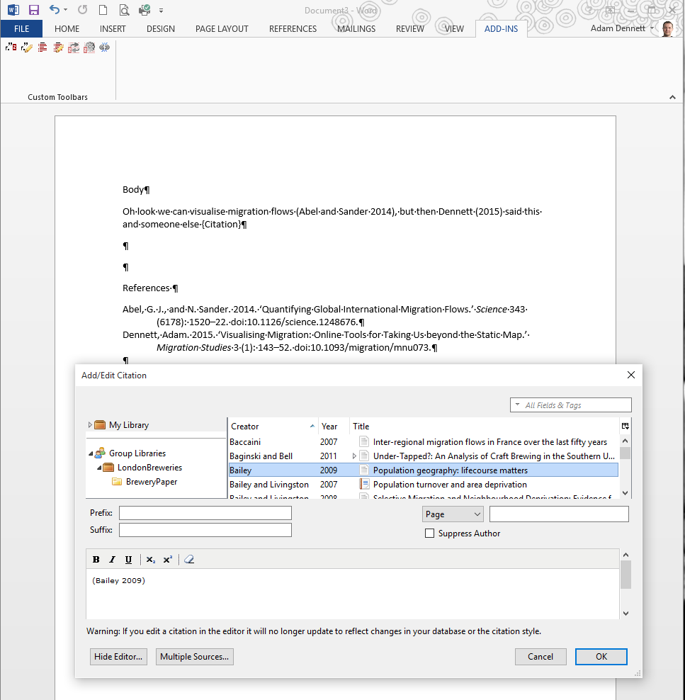
Zotero
Citations can be imported straight into word / Google docs / markdown using a plugin which is installed
Zotero will then build your alphabetical reference list at the end (according to the style you choose!)

Slide 22
Zotero
Your library is stored online (and locally on your computer and synced) so you can access from anywhere
Other reference management software such as EndNote is available (EndNote is good, but quite pricey…)
Mendeley (a free alternative) - https://www.ucl.ac.uk/library/docs/guides/mendeley
Big hint #1 – DOWNLOAD ZOTERO TODAY AND PRACTICE USING IT – IT WILL MAKE YOUR LIFE ABOUT 300% BETTER

Slide 23
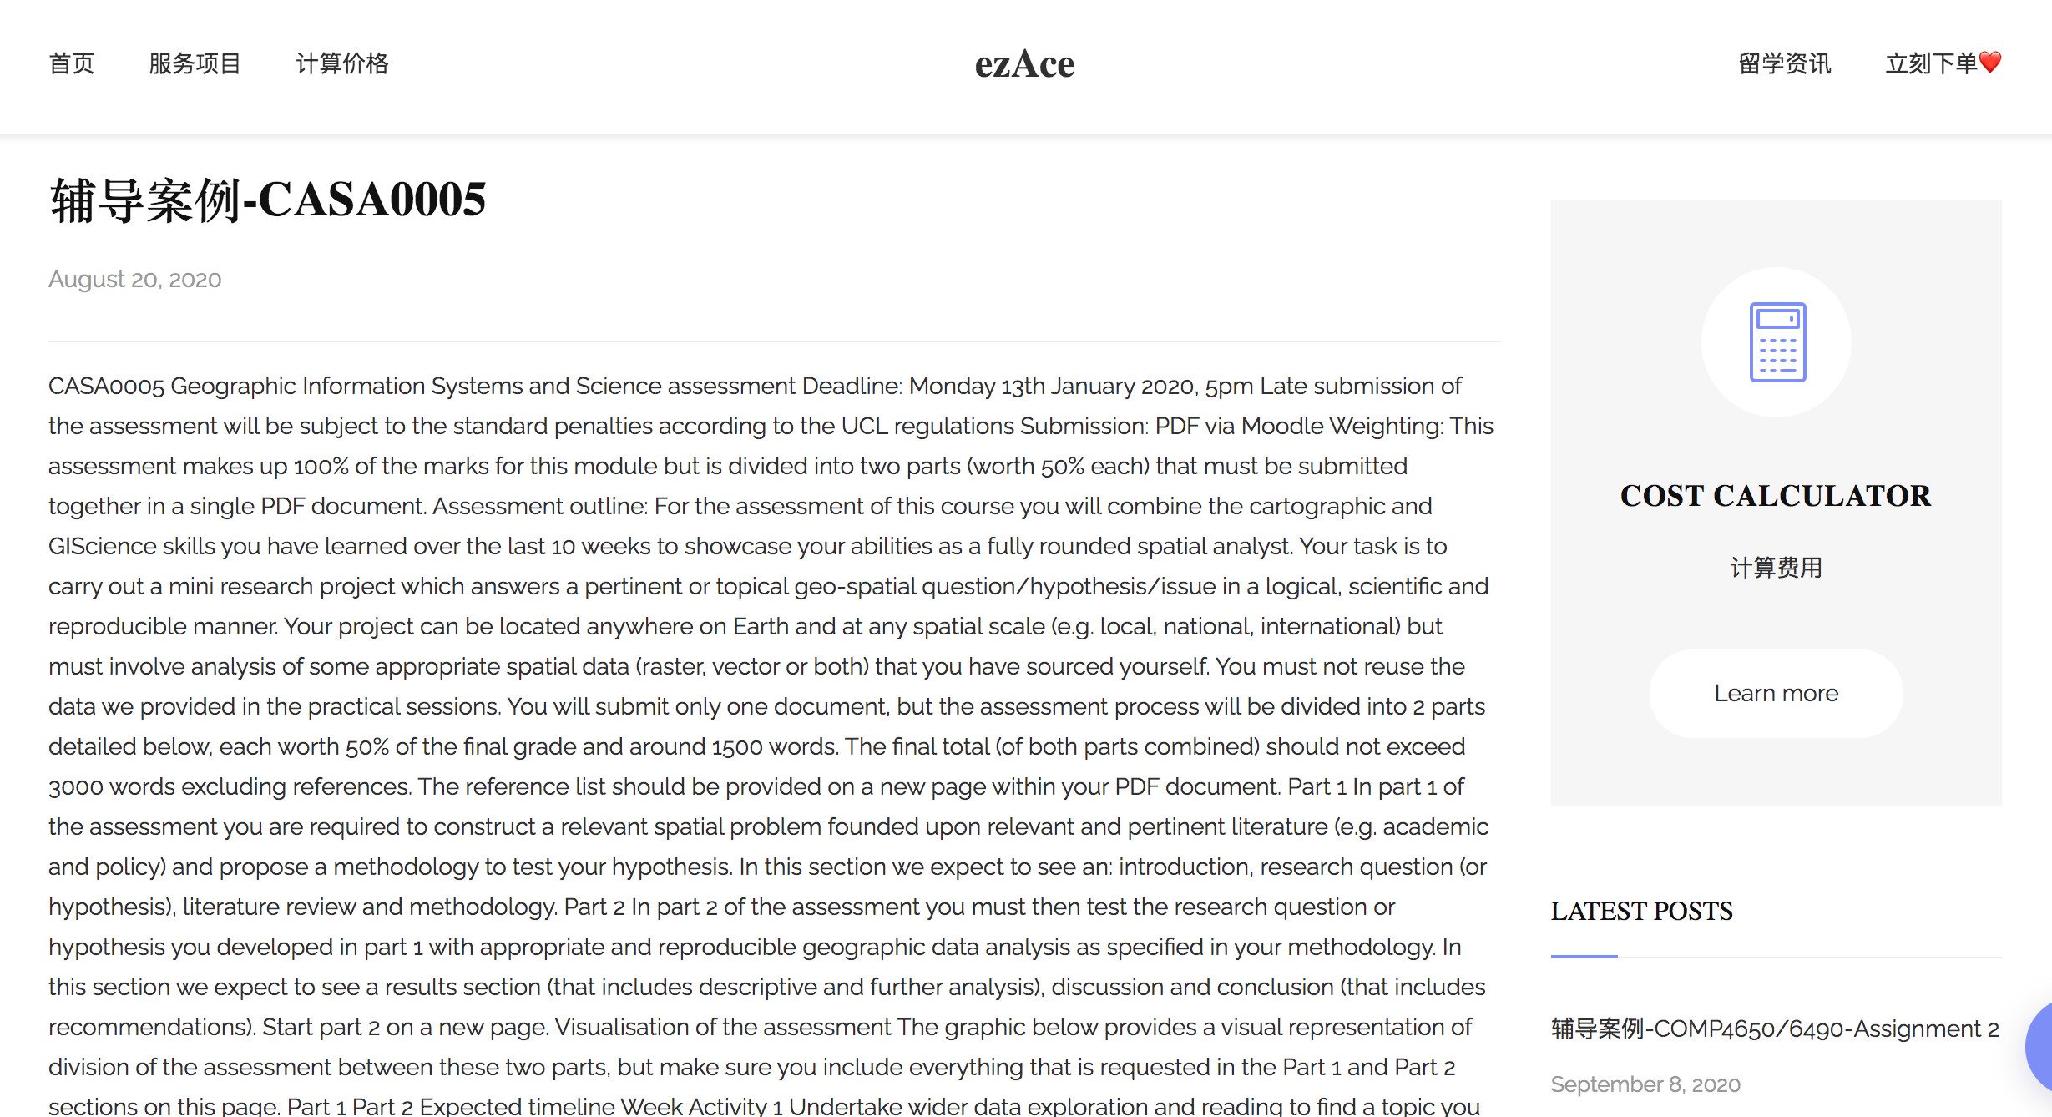
Writing Problem 4 – Plagiarism

Slide 24
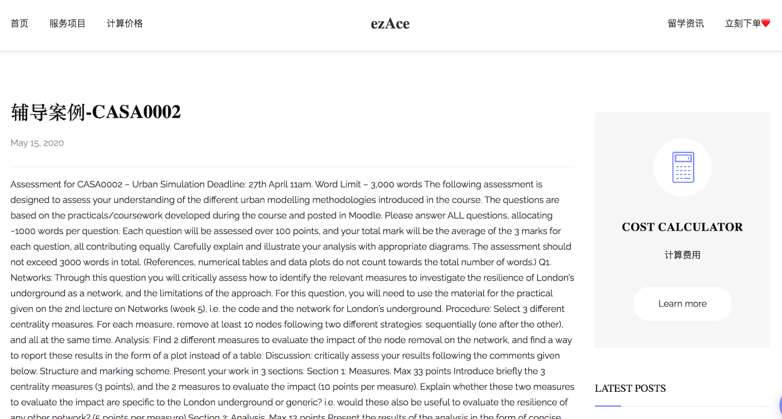
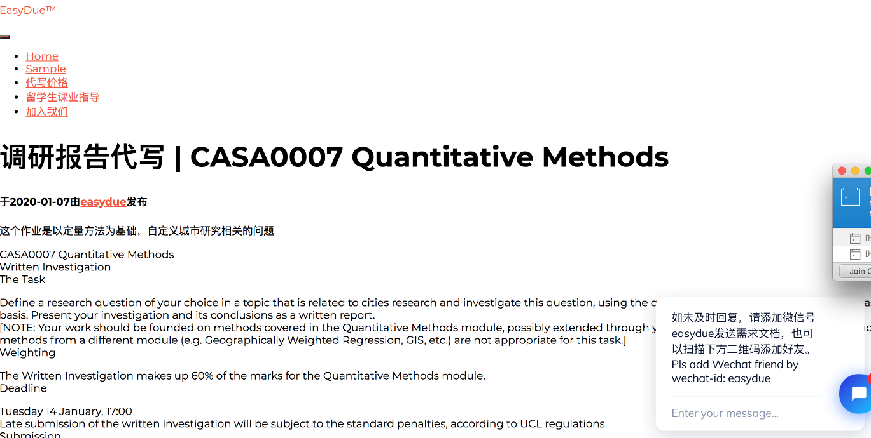
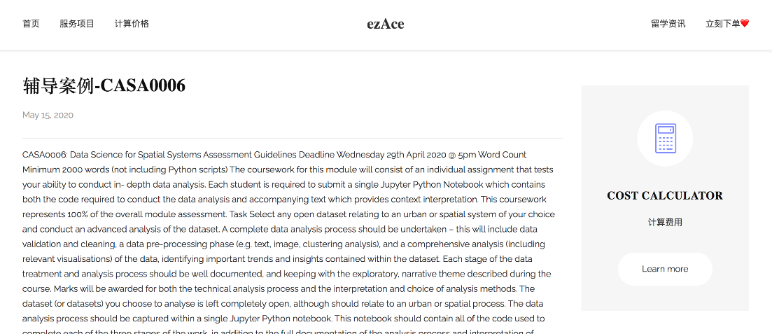
Writing Problem 4 – Plagiarism

Slide 25
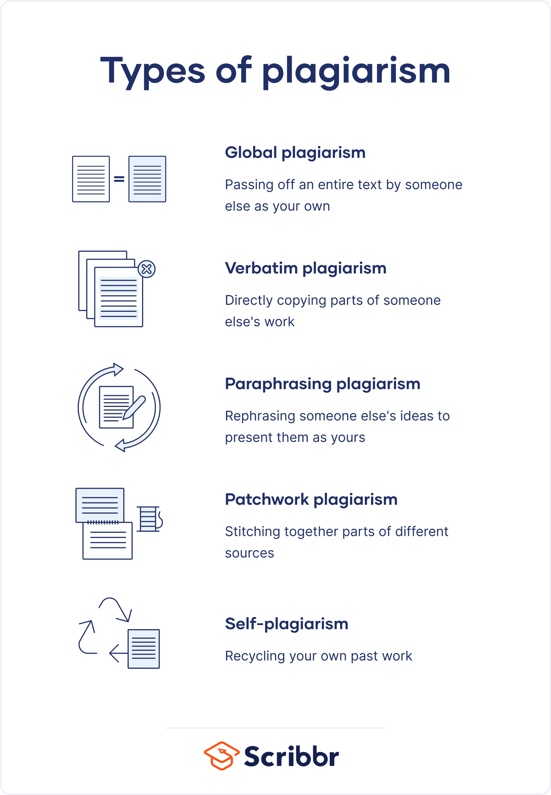
Writing Problem 4 – Plagiarism
What is Plagiarism?
Passing off someone else’s work as your own – perhaps the most serious academic offense and one that could lead to you failing your degree!
Sometimes plagiarism is not malicious, merely the result of lazy referencing (forgetting to cite the person that said… x) – but this is NO EXCUSE! See my last point on Zotero to help with this…
You will get credit every time you reference the work of someone you have read – so make sure you cite them correctly!
We are all experts at spotting plagiarism (indeed it can be a bit of a sport for lecturers), so DON’T DO IT!!

Slide 26
Writing Problem 4 – Plagiarism
Some examples…
An admission case provided a work sample, it was based on the town of Stowe, Vermont, USA. I thought this sounded familiar and it turned out they had directly copied an ArcGIS tutorial for the spatial analyst toolbox.
Students submit .zip files in attempt to avoid their work going through Turnitin. All work goes through Turnitin.
Students just screenshot figures from various web sources or even published papers.
Students try to get around Turnitin by altering enough words to minimise the score. We’ve been doing this for many years and normally easily tell.

Slide 27
Writing Problem 4 – Plagiarism
Some examples…
I have also seen very able students be caught by plagiarism concerns
If in doubt, ask.

Slide 28
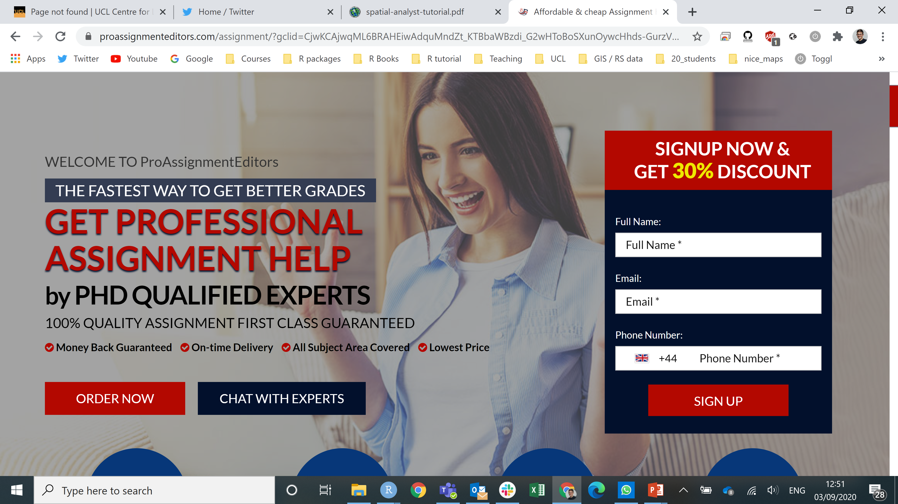
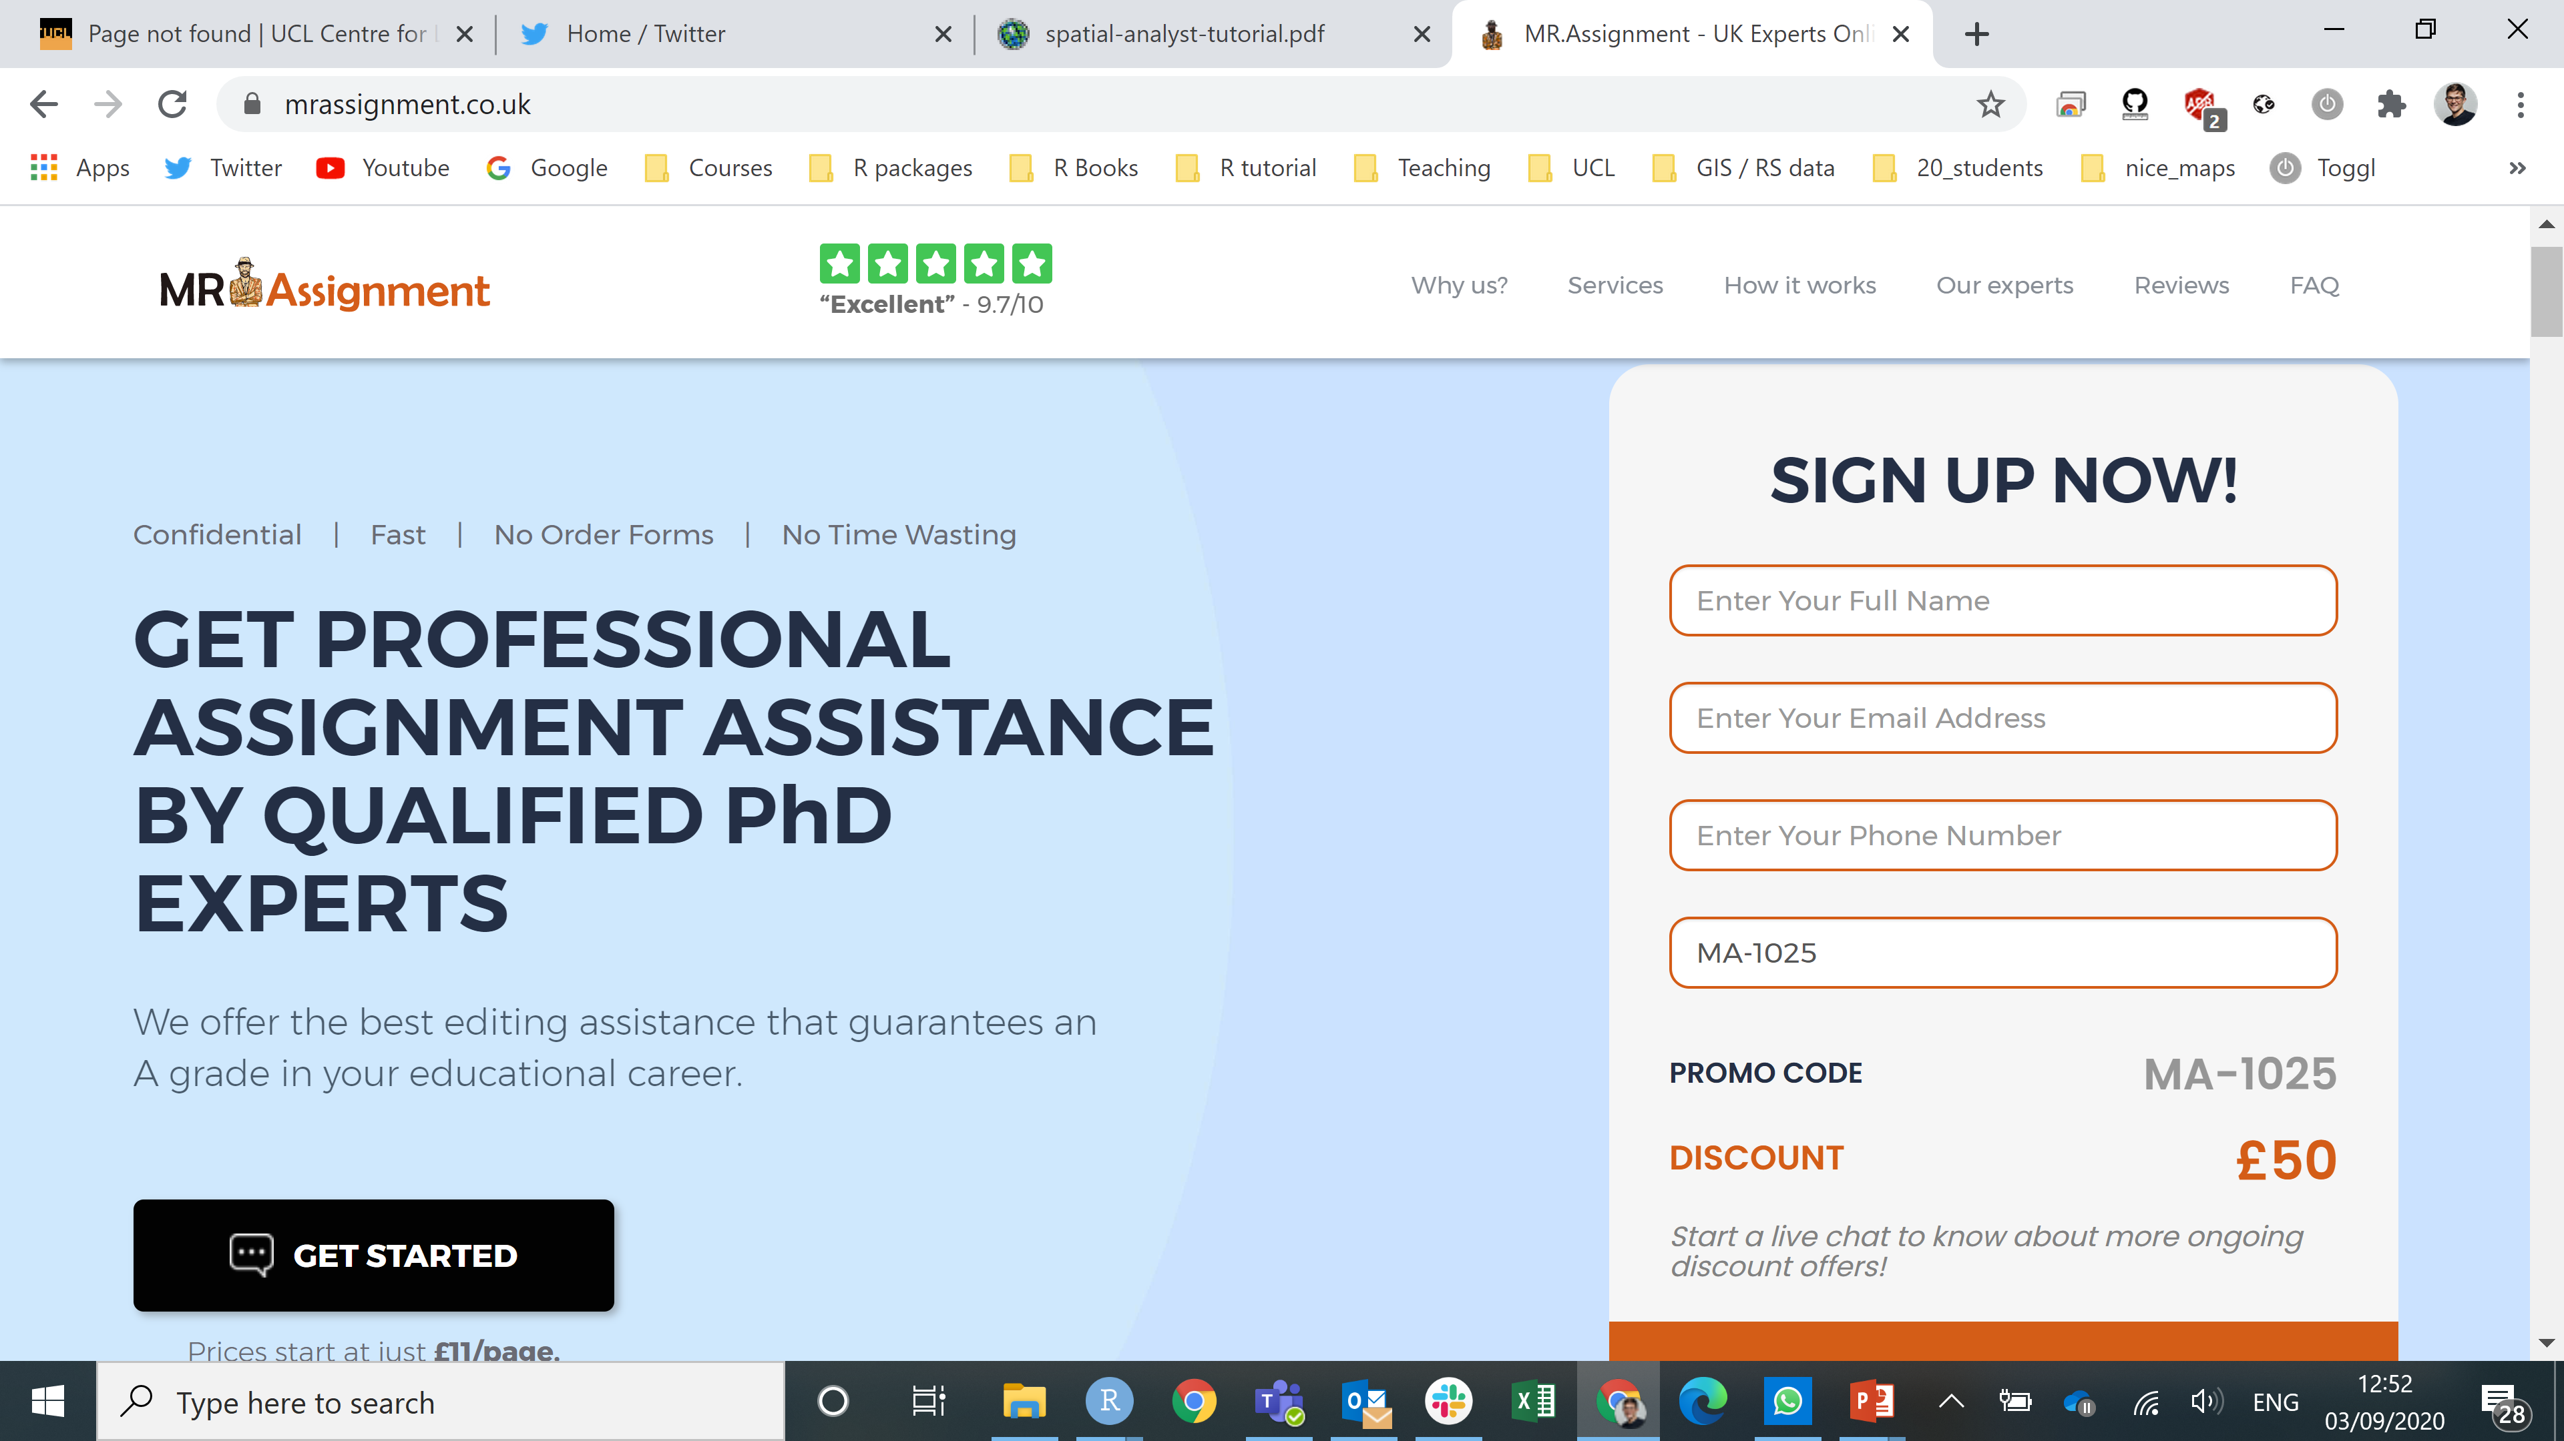
Writing Problem 4 – Cheating
Even has a trusted review, but doesn't link to the website….suspicious

Slide 29
Writing Problem 4 – Cheating
If you use one these companies and we can prove it the penalties are very harsh! They include exclusion at the point and even withholding any qualification you might be eligible for!
Also you run the very real risk of being blackmailed by the company throughout your degree and career.
The types of assignments we set are mostly very specific and these companies often won’t have the necessary skills to complete them to a high standard. Even if you try and add sections to them, it will be obvious.
There are many reasons students might plagiarise or cheat, for example:
Leaving the work until the last minute
Feel overwhelmed and panicking
Having to dedicate time to over personal issues (e.g. health or family)
Talk to the staff if you are facing any issues that could be affecting your studies

Slide 30
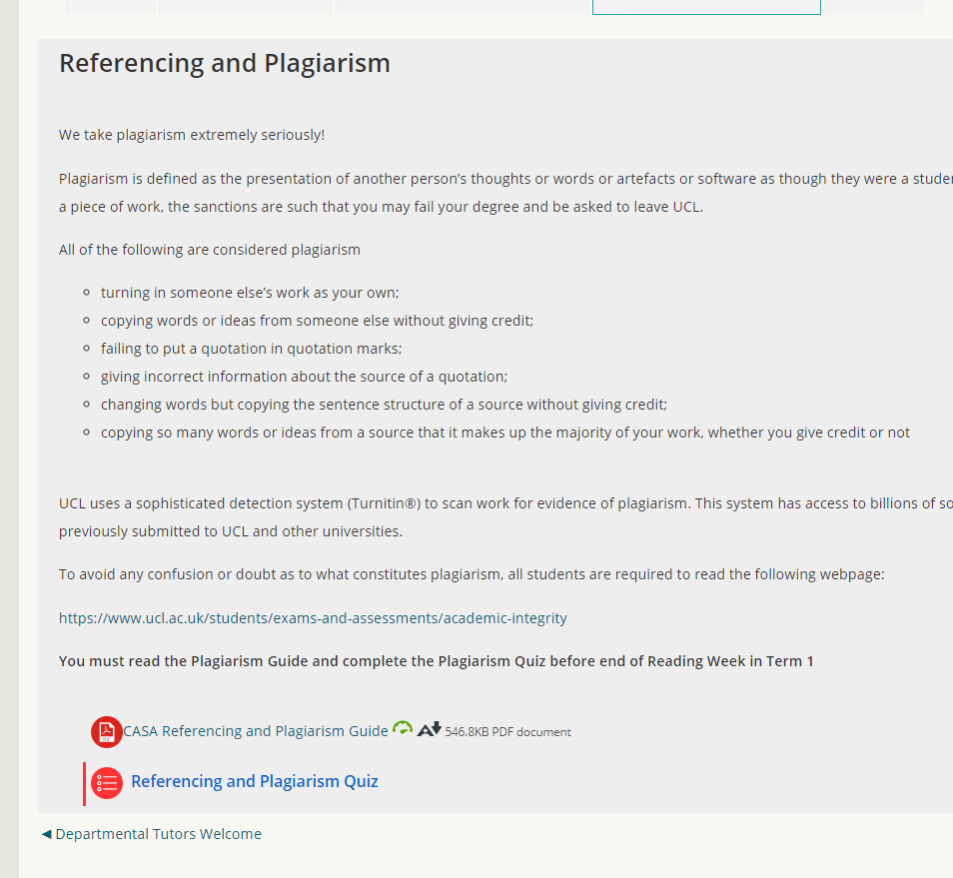
Writing Problem 4 – Plagiarism
Most plagiarism is accidental, so to ensure everyone understands about plagiarism, you all MUST complete the referencing and plagiarism quiz on moodle.
We will log all people who have and haven’t completed and will chase you if you don’t complete it.
Log onto the CASA page – where these slides will be along with other induction week materials and complete the short quiz.

Slide 31
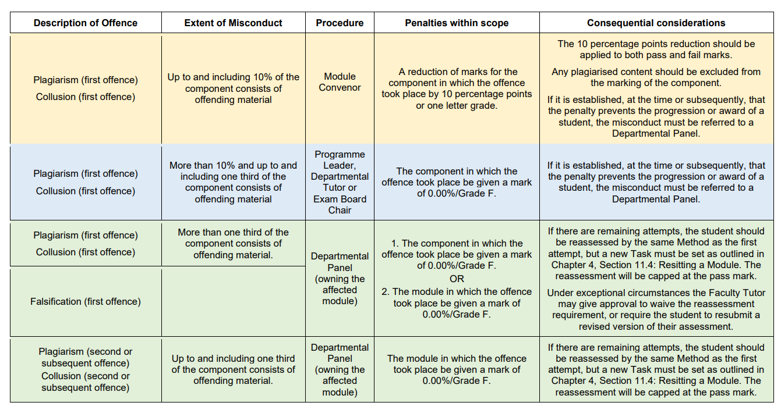
Writing Problem 4 – Plagiarism

Slide 32
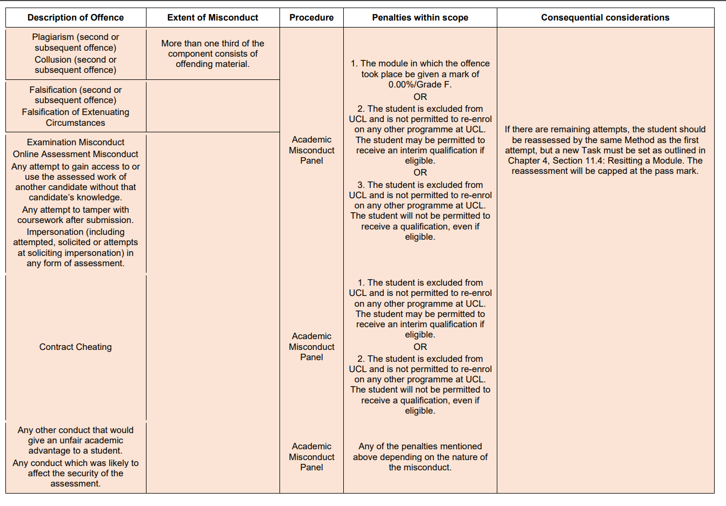
Writing Problem 4 – Plagiarism

Slide 33


Writing Problem 5 – insight, originality and coherence
Original?

Slide 34

Writing Problem 5 – insight, originality and coherence
Coherent?

Slide 35

Writing Problem 5 – insight, originality and coherence
Insightful…?

Slide 36
Writing Problem 5 – insight, originality and coherence
Original: You need to write the assignment in your own words that tells a narrative through the existing research. Don’t just state what others have done
present or existing from the beginning; first or earliest
Coherent: Make your points in a logical manner, with support from literature (or policy documents). Don’t just assume the reader knows what you are talking about because they are an academic. Build the story, don’t just jump to the ending.
logical and consistent
Insightful: Clearly showing that you understand the methods, concepts and debates discussed but also how your analysis (or discussion) did or could add meaning in some way.
having or showing an accurate and deep understanding; perceptive.

Slide 37


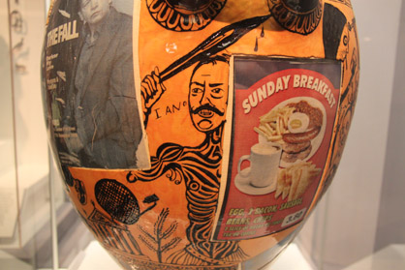
Writing Problem 5 – insight, originality and coherence

Slide 38
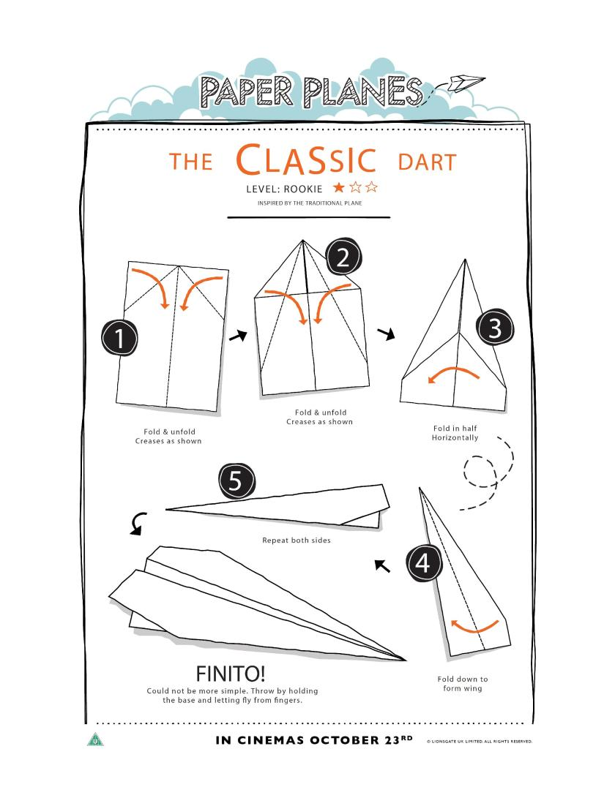

Slide 39
Writing Problem 5 – insight, originality and coherence
Is your paper plane….?
Original:
Did you copy the design (plagiarism?) Or make any changes?
Coherent:
Did you make it in a logical manner or just glue random bits together?
Insightful:
Did you understand what you did / did it advanced paper plane engineering
Hard for a paper plane to have insight

Slide 40
Writing Problem 6 – over complicating things
Don’t try and sound too clever or technical – it’s obvious to a marker when you don’t really know what you’re talking about!
If in doubt, Keep it simple – you will get far more credit for presenting some simple ideas that are well explained, rather than something that is apparently complex but irrelevant or poorly chosen
Lead the reader through your thought process – don’t make them guess why you are doing something or how you came to a particular point of view
“If you cannot explain something in simple terms, you don’t understand it yourself” – Feynman (or Einstein – or neither!)

Slide 41
Writing Problem 6 – over complicating things
K - Keep
I - It
S - Simple
S - Silly.

Slide 42
Writing Problem 7 – Your approach to your essay
Task 2 (3-5 Minutes)
Look at the list of comments from the essays which scored the lowest and highest marks in previous years’ (some from the last two years) Urban Systems Theory Essays
Note down a list of some of the common criticisms in the markers’ comments as well some of the things that we like to see

Slide 43
What are some of the common issues raised by the marker?

Slide 44
Key to success #2: Writing
TOP TIP #1 – Look for the mark scheme for each assessment for each module on Moodle. These will help you understand what we are looking for and will help you structure your essays…
TOP TIP#2 – Don’t just regurgitate a load of facts:
1. Explore a range of different perspectives BUT DO NOT just list them tell a story though a narrative. E.g. Task 3
2. Be CRITICAL of what you read
3. Bring some of your own perspective into your work to make it stand out – you all have different experiences and backgrounds, take advantage of this.
TOP TIP#3 – What does this add?
TOP TIP#4 – Look at past examples and try to grade them yourself

Slide 45
Writing Problem 7 – Your approach to your essay
Task 3 (3-5 Minutes)
Compare the version 1 and version 2 of the same paragraph. Answer the question… why is version 2 better

Slide 46
Why is version 2 better?

Slide 47
Key to success #3: Time Management
Check when all of your assignment deadlines are and put them in your diary.
If you’ve got three assignments all due in at the end of term, don’t save them all until the end – if you can, get some done early (by reading week!)
Don’t hand in anything late – the penalties are very severe!!
10 percentage points for 0 to 2 days late
Mark capped at 50% for 2 – 5 days late
More than 5 days late – 1%

Slide 48
Key to success #3: Time Management
A masters degree (MSc, MA, MRes) is a LOT of work.
An Average: 150 hours for each 15 credit module = 15hrs a week = 3hrs per day, per module (for a 5 day week)
4 modules per term =
12 hrs per day of work (5 day week)
10 hrs per day of work (6 day week)
8.5 hrs per day of work (7 day week)
None of this above includes the 7 days for reading week or holidays at the end of term, so not quite this heavy.
Treat it like a 9am-5pm job and you will be fine…! But remember to build in some time off!

Slide 49
Key to success #3: Time Management
UK Masters Degrees are largely SELF-GUIDED
This means YOU have to decide what to work on and when outside of classroom hours – we won’t tell you exactly what to do, you have to decide for yourself
#Tip: Devise a weekly timetable for working outside of class – treat your Masters year like a job
Don’t over commit yourself…you don’t need to be doing internships whist doing the MSc. Within the dissertation module there are plenty of opportunities to work on research projects in the department and with external partners.

Slide 50
Key to Success #4: Creativity
In this degree, we will ask you to be creative – many of the essay questions and assessment tasks require you to define or identify your own problems to address e.g.
Come up with an interesting urban problem to look at that spatial data and spatial analysis techniques could help solve…start simple and visualise the data
Issue: “I’m not a creative person…”
Solution:
Creativity problems can largely be solved through being more aware of what other people have done / are doing in a given area. READ WIDELY.
Think of how the methods you’ve been taught could be applied to other countries, data or situations
Ask yourself how policies / literature could have been done better or even made use of spatial data. Or how does one country / paper compare to others.
Think if the solution you’ve read is data informed or could it be improved.
This is being critical, you can apply this logic to almost anything…reflect on your day, what went well and not so well, what could you do in future to improve things?

Slide 51
Key to Success #5: Resitting failed work
Sometimes things can go wrong for various reasons.
You get 2 attempts to pass a module, passing is 50 or more:
1. If you fail a module first time, speak to your module leader to find out what went wrong and how you can correct it a second time
2. Don’t fail a second time – if you fail a second time, then you cannot pass a module and you will not gain enough credits to complete your masters degree
You can also have 2 modules ‘pass condoned’ if they are between 40 and 49 (not the dissertation).

Slide 52

Key to Success #6: Talk to us
You could email an academic to ask a question, typically they will reply in 3-5 working days.
For anything non-personal in nature then you should be using slack. Typical response time 1 day (although varies based on staff on the module).
What always happens after the first lectures is that we get lots of emails asking the very same questions. By term 3 everyone will ask questions on slack.
Slack intro: https://www.youtube.com/watch?v=6wjmH5qL3Ms

Slide 53
Key to Success #6: Talk to us
Important things to note
There are no ‘stupid’ questions
But you can ask the right questions….”it just doesn’t work and I haven’t tried to fix it”
You are never bothering us to ask a question
If someone can’t pronounce something it means they learnt it from a book. This is a good thing. I constantly mispronounce things.
To get where we are, we have sat where you sit now
If you aren’t comfortable using your name on slack you can be anonymous…
Do email for personal issues and tell us things that might impact your studies before deadlines
Did I say there are no stupid questions

Slide 54
Key to Success #6: Talk to us
An example of a question to ask on slack
Problem: You can’t load a shapefile file (common file in spatial analysis).
Pick question 1 or 2
Hey Andy. I can’t load this shapefile, can you help?
Hey Andy. I can’t load this shapefile. I’ve checked the workshop materials (section x) and online (insert website) and know I need several files and not just the .shp but I’m not sure what I’m missing, could you please have a look? (screenshot taken of the files)
If your question involves code or analysis then try to give the minimum worked example (or MWE)

Slide 55
Why is question 2 better?

Slide 56

Key to Success #6: Talking
= Questions that you want answered by the teaching team for the module or questions that you want to discuss with each other knowing the staff can help
= Personal / administration issues only. If you ask a question about module or assignment content expect “please ask this question on slack” between 1 and 5 days later.

Slide 57
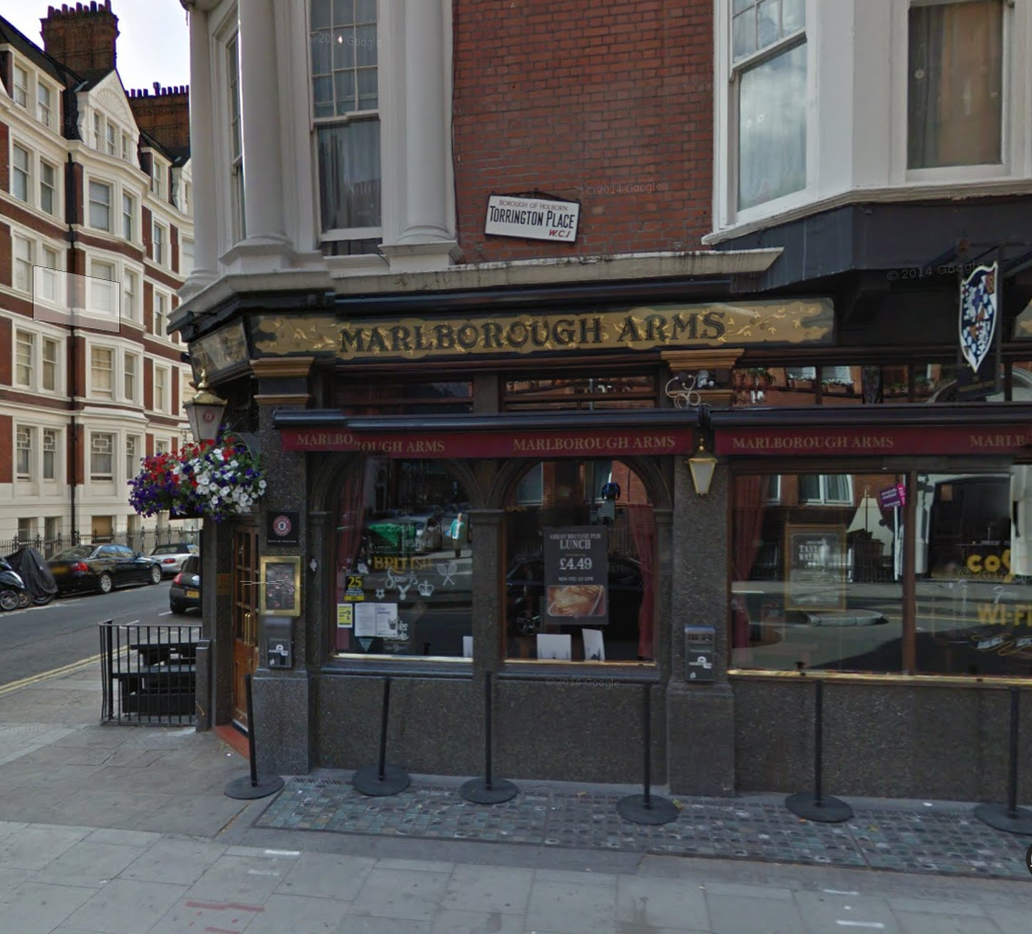
Key to success #7: Socialise with your course-mates… and us!
Talk to each other – you will learn as much from each other as you do from us and much of this learning will be informal!
Come along to Wednesday post-seminar drinks with us – chatting informally will:
Help improve your English
Might spark ideas for dissertation
Give you the opportunity to ask informal questions to us
Help everyone get to know each other better

Slide 58

Key to success #7: Socialise with your course-mates and us
Top Tips for Navigating the Great British Pub
Drinking beer is not mandatory (but advised?)
If you don’t drink beer, you can still come to the pub – an excellent, cheap and thoroughly acceptable alternative to beer is:
“A half of lime and soda”
A half of lime and soda – note the luminous green hue…

Slide 59

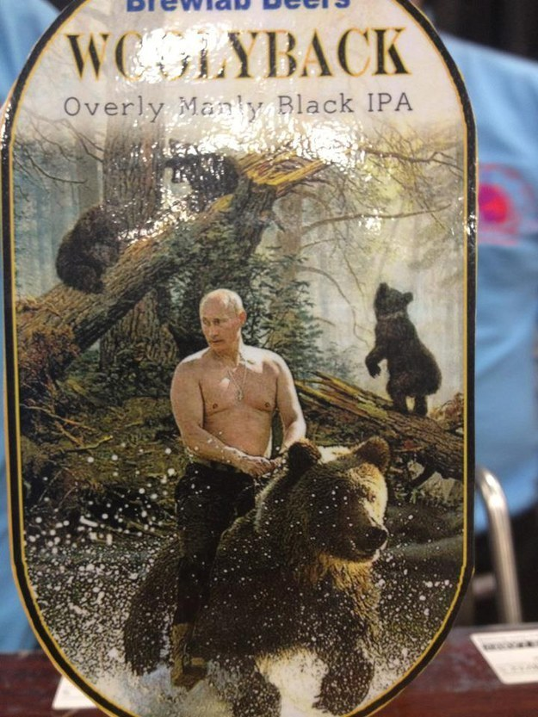
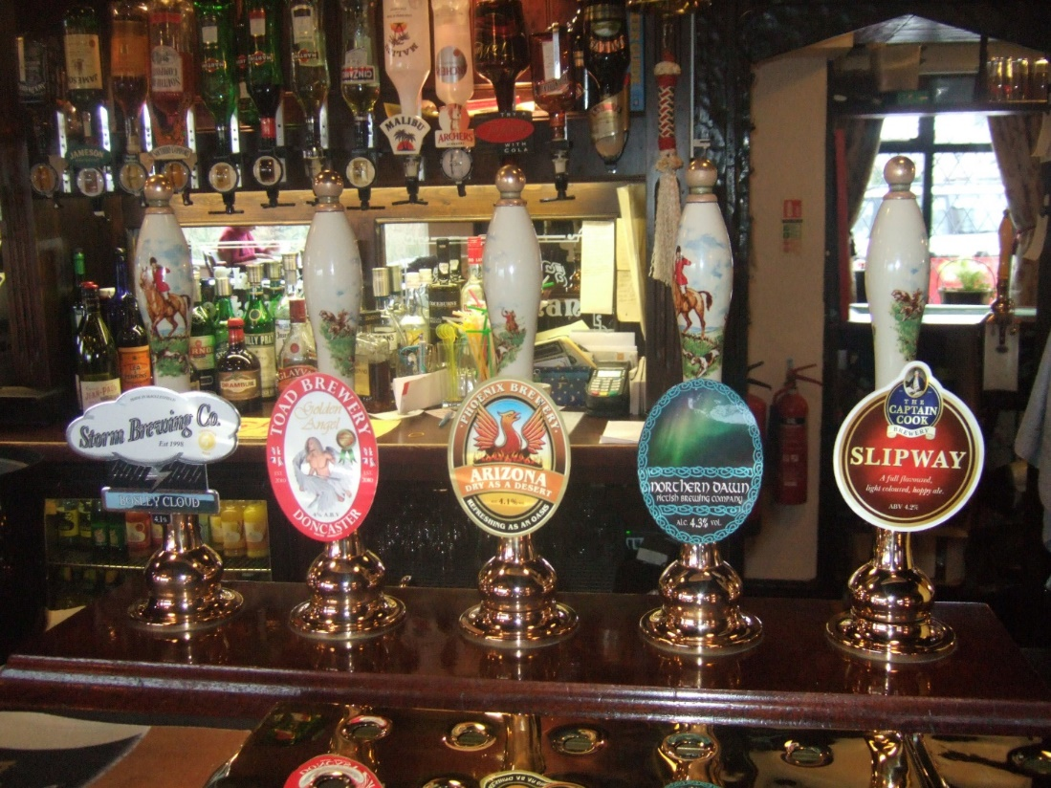





Key to success #7: Socialise with your course-mates and us
If you do drink beer, don’t drink crappy imported larger from some international brand
Select something from a hand pump as this will be the good stuff! Hand pumped Cask Ale is what Britain was built upon! As a general rule of thumb, the weirder the name and stranger the picture on the pump, the more interesting and better the beer!
Craft Keg Beer is also acceptable

Slide 60

Key to success #7: Socialise with your course-mates and us
Order either a ‘pint’ –e.g. “A pint of your finest India Pale Ale please, barkeep”
Or a ‘half’ – e.g. “I might just have to go for a half of Hoptimus Prime please – I’m still hanging from last night”
Don’t be scared of ‘rounds’ – just because someone offers to buy you a drink in a round, it doesn’t mean you have to buy a whole round back (especially if it’s a rich Professor!)
A Pint
A Half

Slide 61
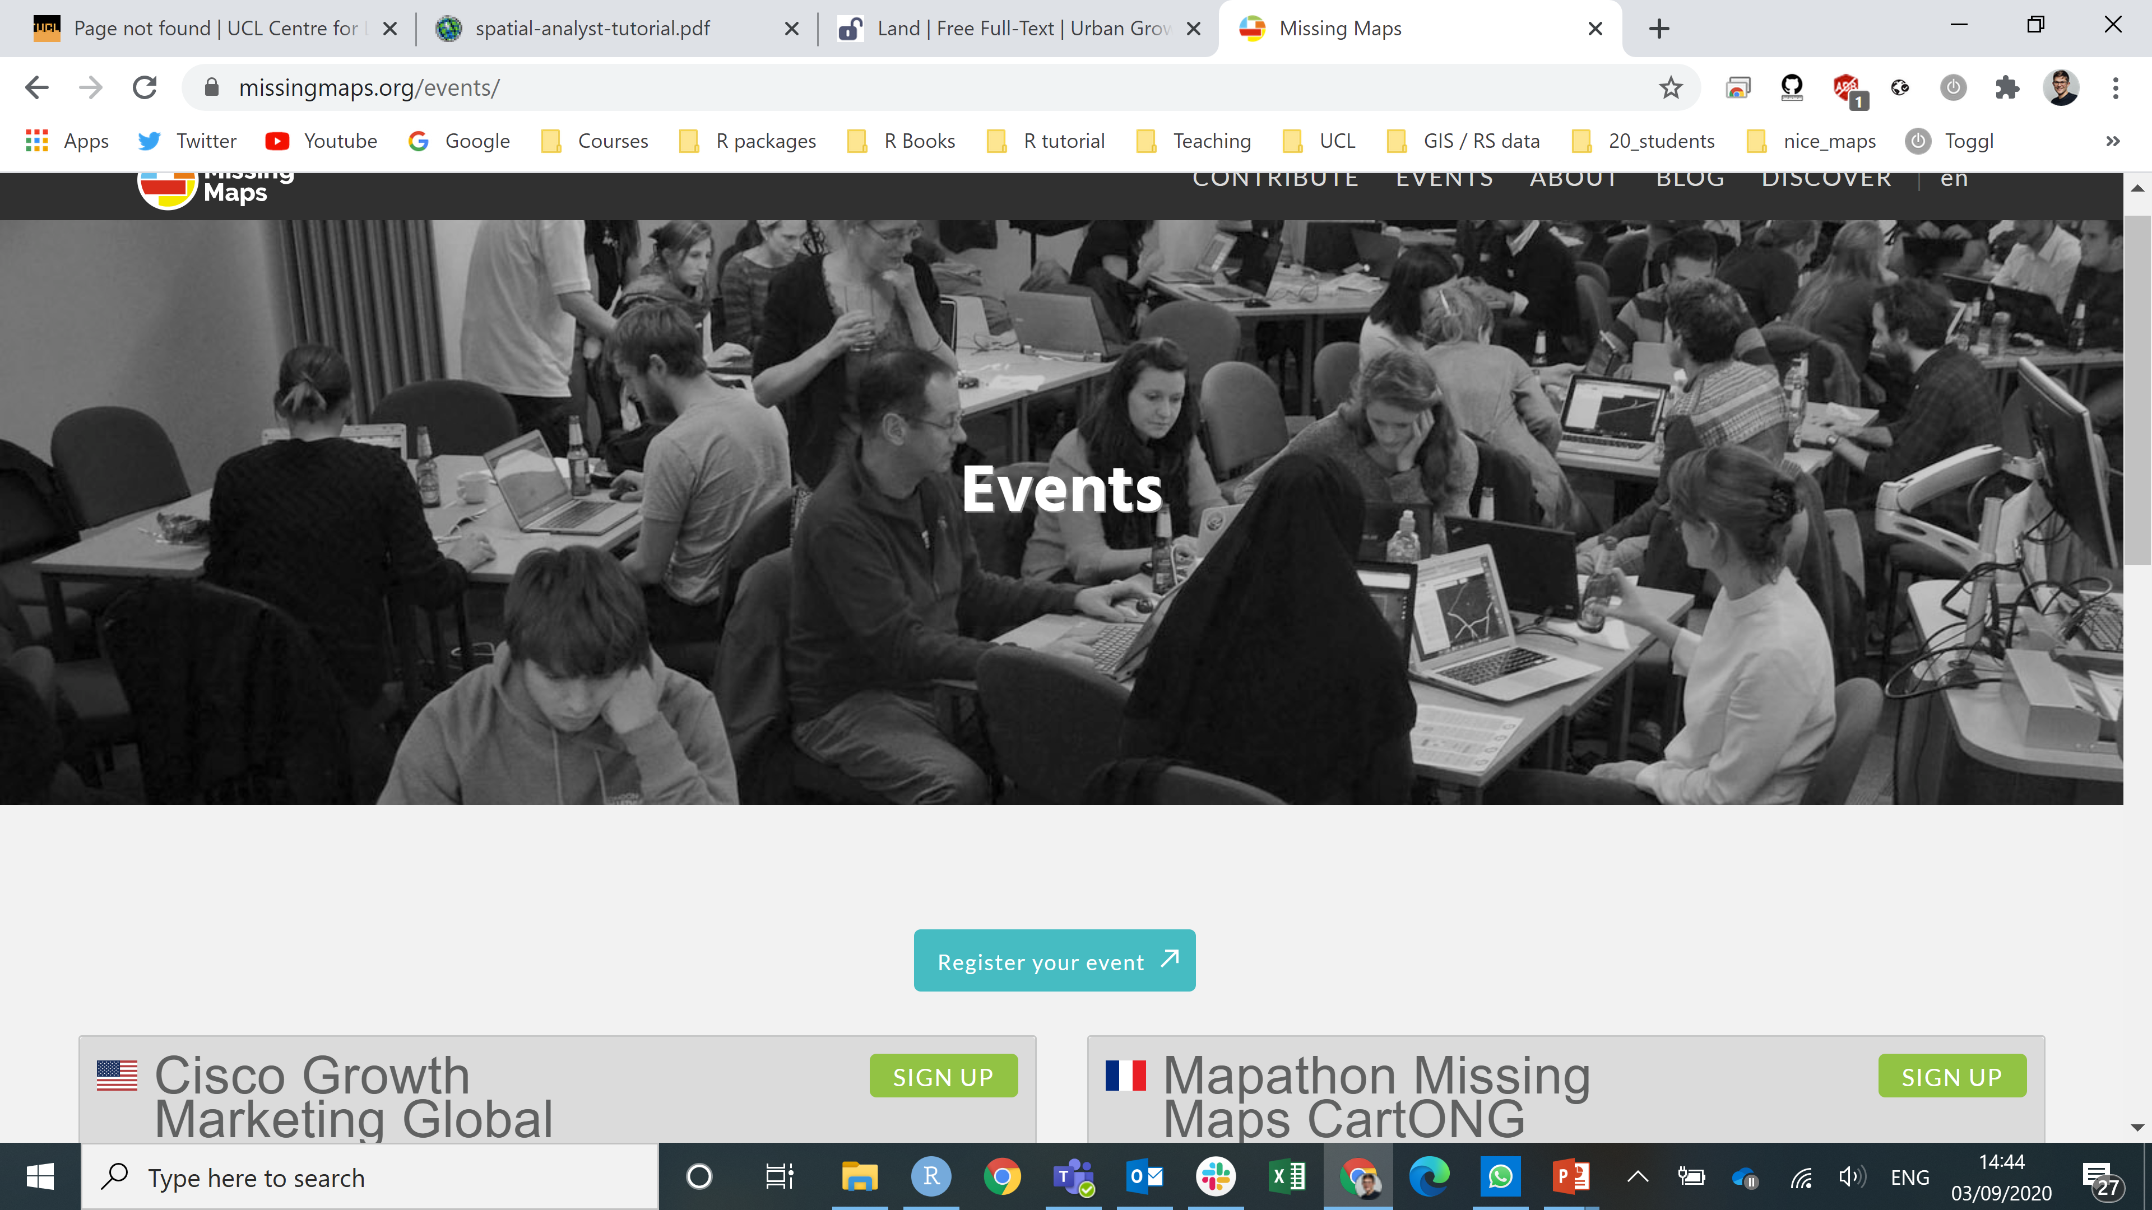
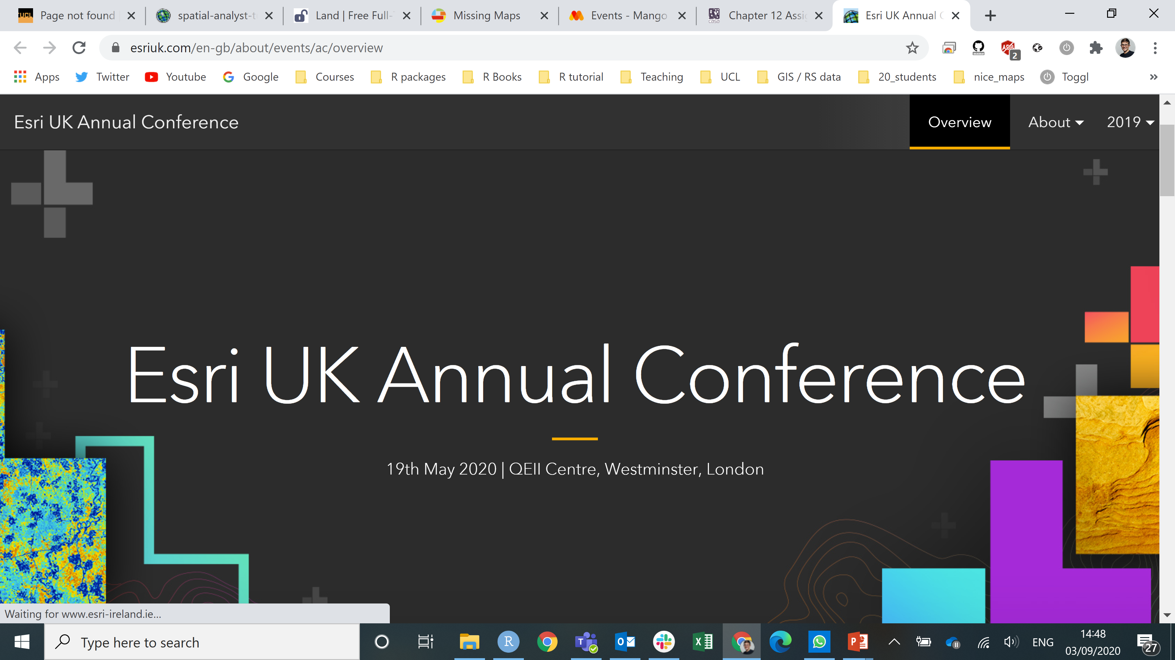
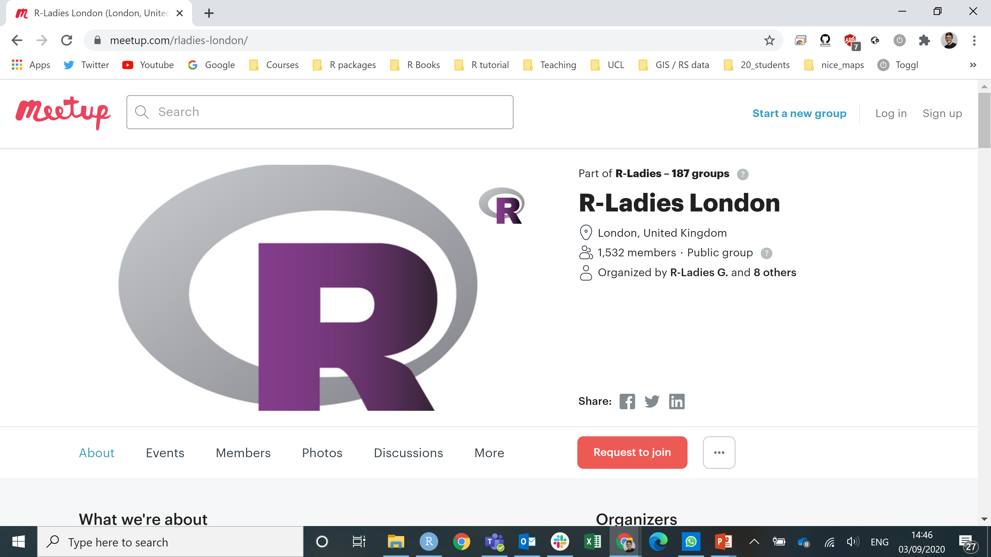
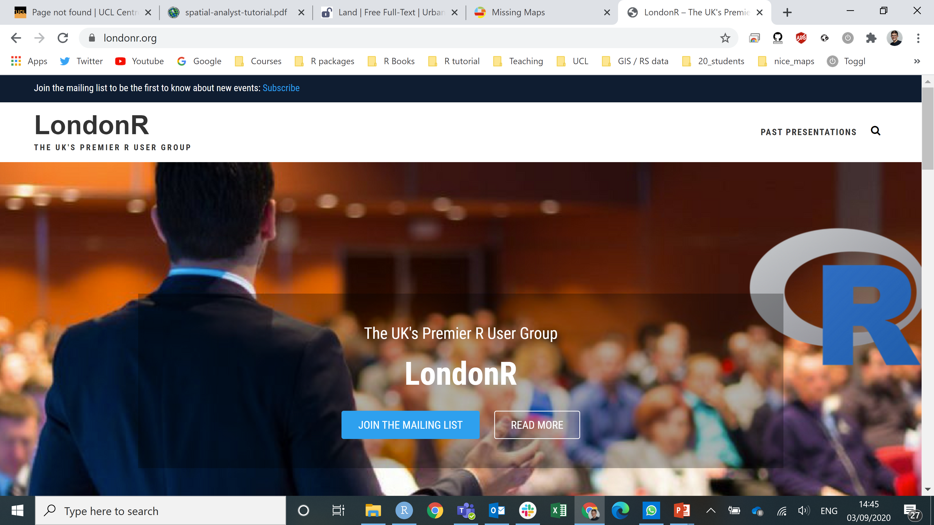
Key to success #8: Put yourself out there
This is probably one of the most scary things to do but also it’s one of the most important.
A lot of the CASA staff develop ideas and collaborations through talking to other, external people.
You can do this too. Don’t be afraid.

Slide 62

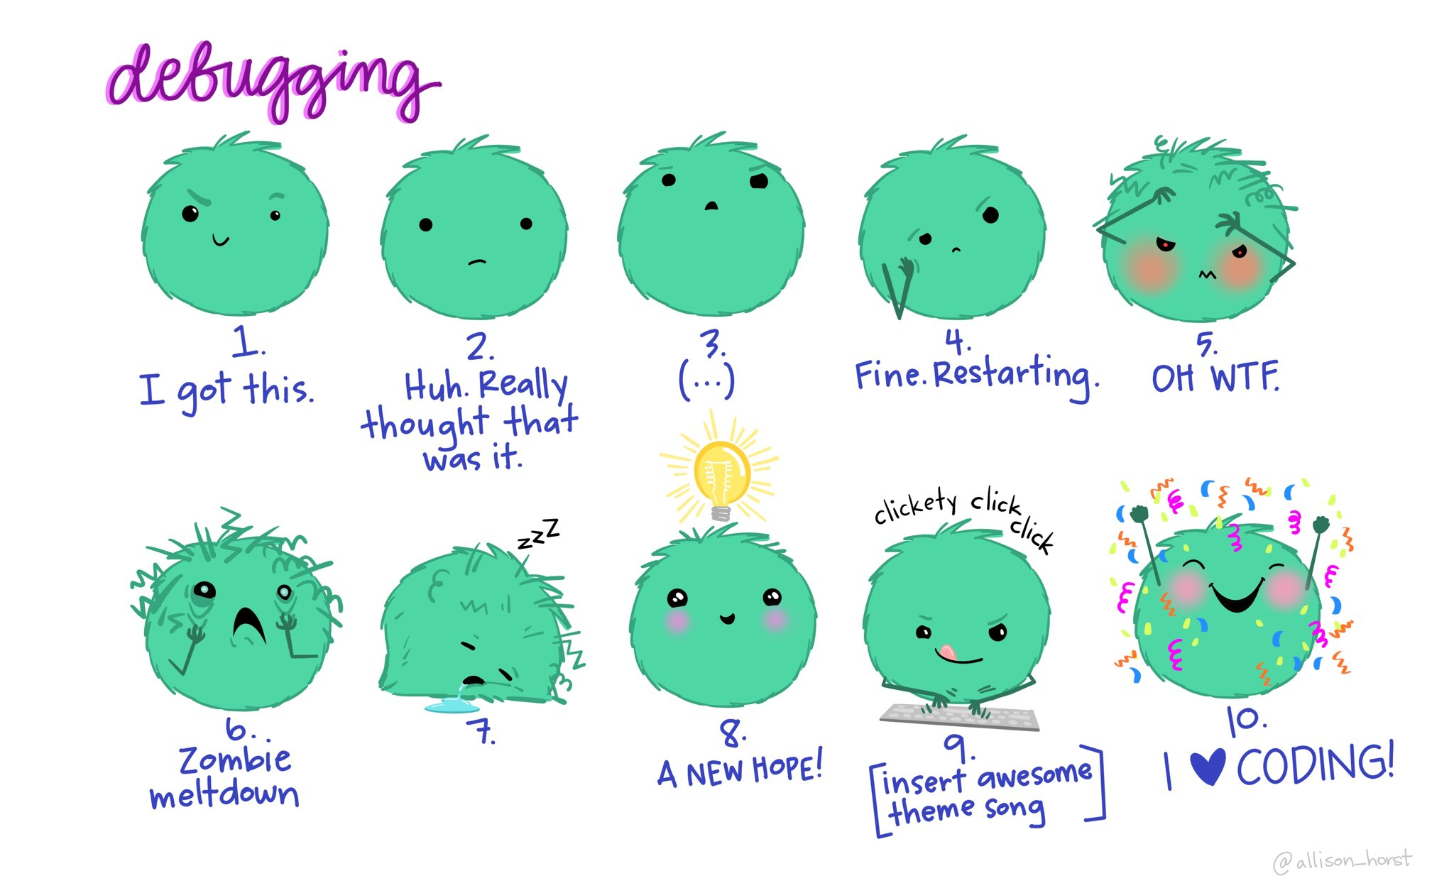
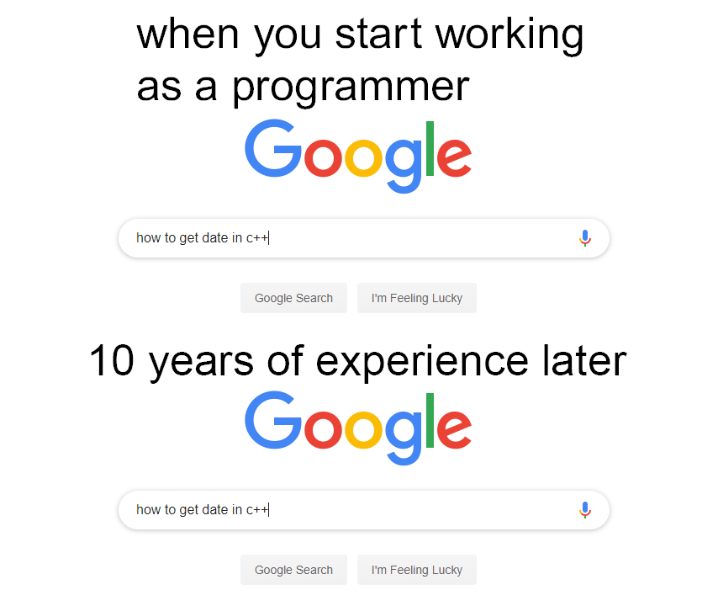
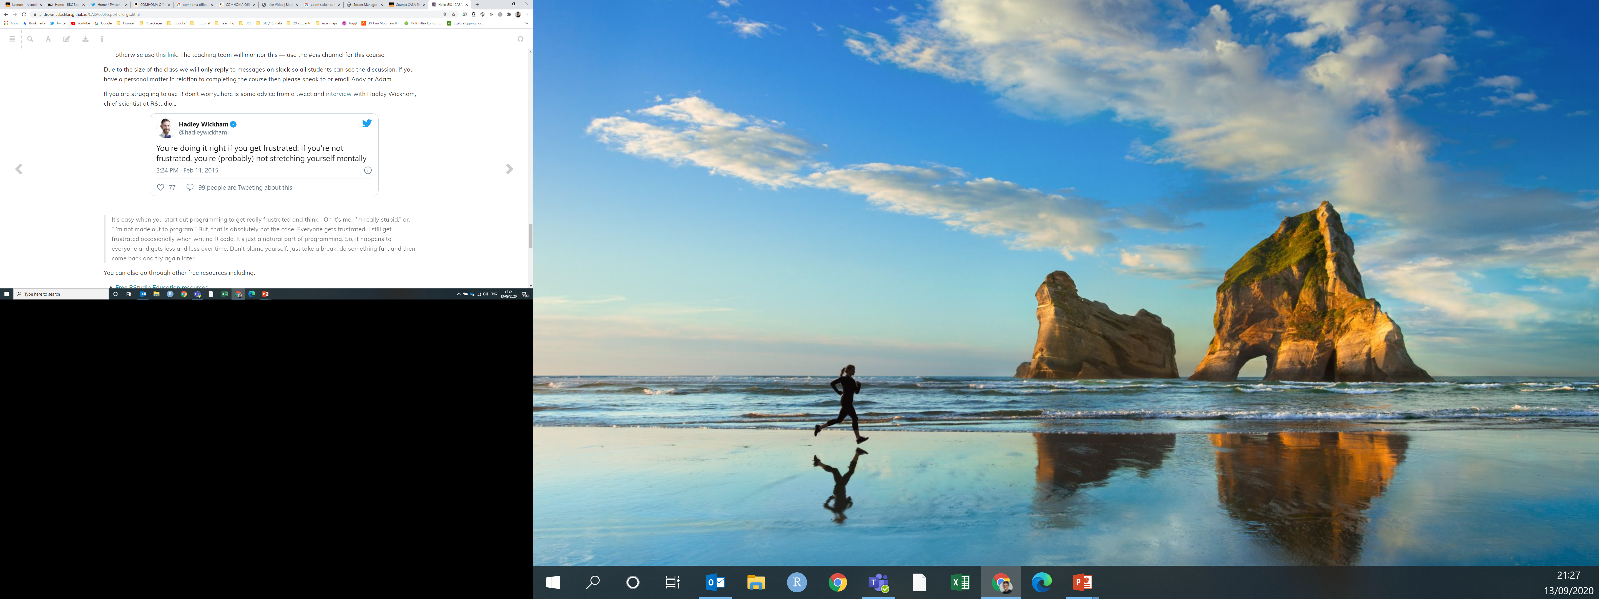

Closing thoughts

Slide 63
Homework
Download and use Zotero! TODAY!!!
Complete the plagiarism quiz
Link your Google scholar search to the UCL library
Sign up to CASA slack
Do some wider reading:
Give cities a seat at the top table, Acuto 2016
Scientists must have a say in the future of cities, McPherson 2016
Global science for city policy, Acuto 2018
Explore the writing lab
Make a personal timetable you will work to (will develop over time)
Explore UCL libraries, student centre etc

Slide 64
Any Questions?

